Slide 2
PROBLEM STATEMENT:
Manholes are critical access points for underground utilities, but they pose significant safety risks due to the accumulation of hazardous gases and extreme temperature fluctuations. Toxic gases like methane and hydrogen sulfide can accumulate, leading to potential health hazards, explosions, or environmental contamination, while excessive temperatures may indicate electrical faults or other underlying issues. Traditional inspection methods are manual, inefficient, and reactive rather than proactive.
OBJECTIVE:
The objective of this project is to develop a real-time Manhole Monitoring System that continuously measures gas concentrations and temperature levels inside manholes. By integrating IoT-based sensors and wireless communication, the system will provide early warnings to prevent accidents, ensure worker safety, and enable timely maintenance, thereby improving overall urban infrastructure management.

Slide 3
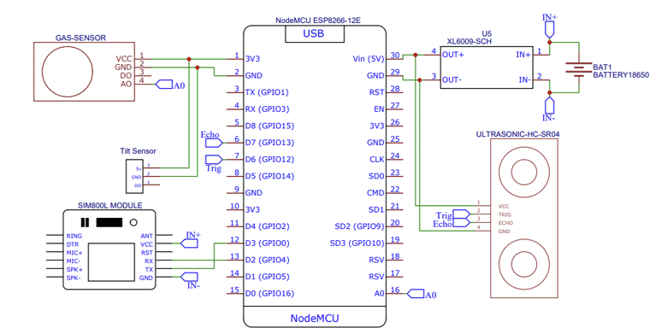
COMPONENTS USED: CIRCUIT DIAGRAM:
NodeMCU
SIM800L GSM Module
MQ Gas Sensor
KY-017 Mercury Tilt Switch Module
JSN SR-04T Waterproof Ultrasonic Sensor
18650 Cell & Cell Holder

Slide 4
PROJECT OUTCOME:
The Manhole Monitoring System will provide real-time data on gas concentration and temperature levels, ensuring early detection of hazardous conditions. The system will enhance worker safety by reducing exposure to toxic gases and overheating risks, while also preventing accidents such as explosions or infrastructure failures. With IoT-based alerts and remote monitoring, authorities can take timely action, improving maintenance efficiency. This solution will contribute to smarter urban management by ensuring safer and more reliable underground utility access. Ultimately, it will minimize manual inspections, reduce operational costs, and enhance public safety.

